Slide 1
CNNs and LSTMs
By
Ajit Jaokar
Oct 2020

Slide 2
Timings
10:00 – 11:30 and
12:30 – 14:00 and
break times
5 mins around 10:45 and 13:15 (break slide as shown next)
We will be there 10 mins before session

Slide 3
Steps for building a model in Keras

Slide 4
We can summarize the construction of deep learning models in Keras as follows:
1. Define your model. Create a Sequential model and add configured layers.
2. Compile your model. Specify loss function and optimizers and call the compile()
function on the model.
3. Fit your model. Train the model on a sample of data by calling the fit() function on the model.
4. Make predictions. Use the model to generate predictions on new data by calling functions such as evaluate() or predict() on the model.

Slide 5
The first example of Keras code
The initial building block of Keras is a model, and the simplest model is called sequential. A sequential Keras model is a linear pipeline (a stack) of neural networks layers. This code fragment defines a single layer with 12 artificial neurons, and it expects 8 input variables (also known as features):
from keras.models import Sequential model = Sequential()
model.add(Dense(12, input_dim=8, kernel_initializer='random_uniform'))

Slide 6
A real example — recognizing handwritten digits
we will build a network that can recognize handwritten numbers.
For achieving this goal, we use MNIST - MNIST is like the hello world of Deep Learning
a database of handwritten digits made up of a training set of 60,000 examples and a test set of 10,000 examples.
The training examples are annotated by humans with the correct answer.
For instance, if the handwritten digit is the number three, then
three is simply the label associated with that example.

Slide 7
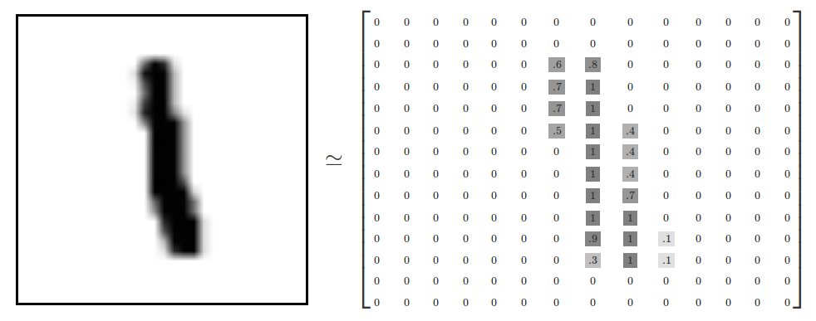
https://www.tensorflow.org/get_started/mnist/beginners
Each image is 28 pixels by 28 pixels. We can interpret this as a big array of numbers. We can flatten this array into a vector of 28x28 = 784 numbers(reshaping an array).

Slide 8
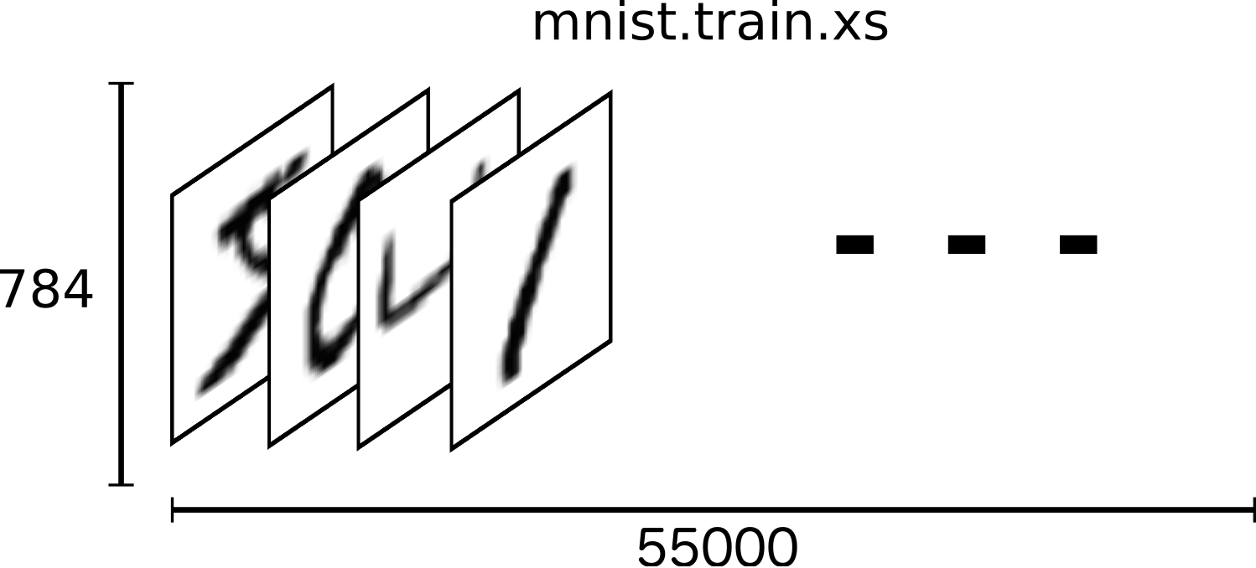
https://www.tensorflow.org/get_started/mnist/beginners
In the above, we thus have a tensor (an n-dimensional array) with a shape of [55000, 784]. The first dimension is an index into the list of images and the second dimension is the index for each pixel in each image. Each entry in the tensor is a pixel intensity between 0 and 1, for a particular pixel in a particular image.

Slide 9
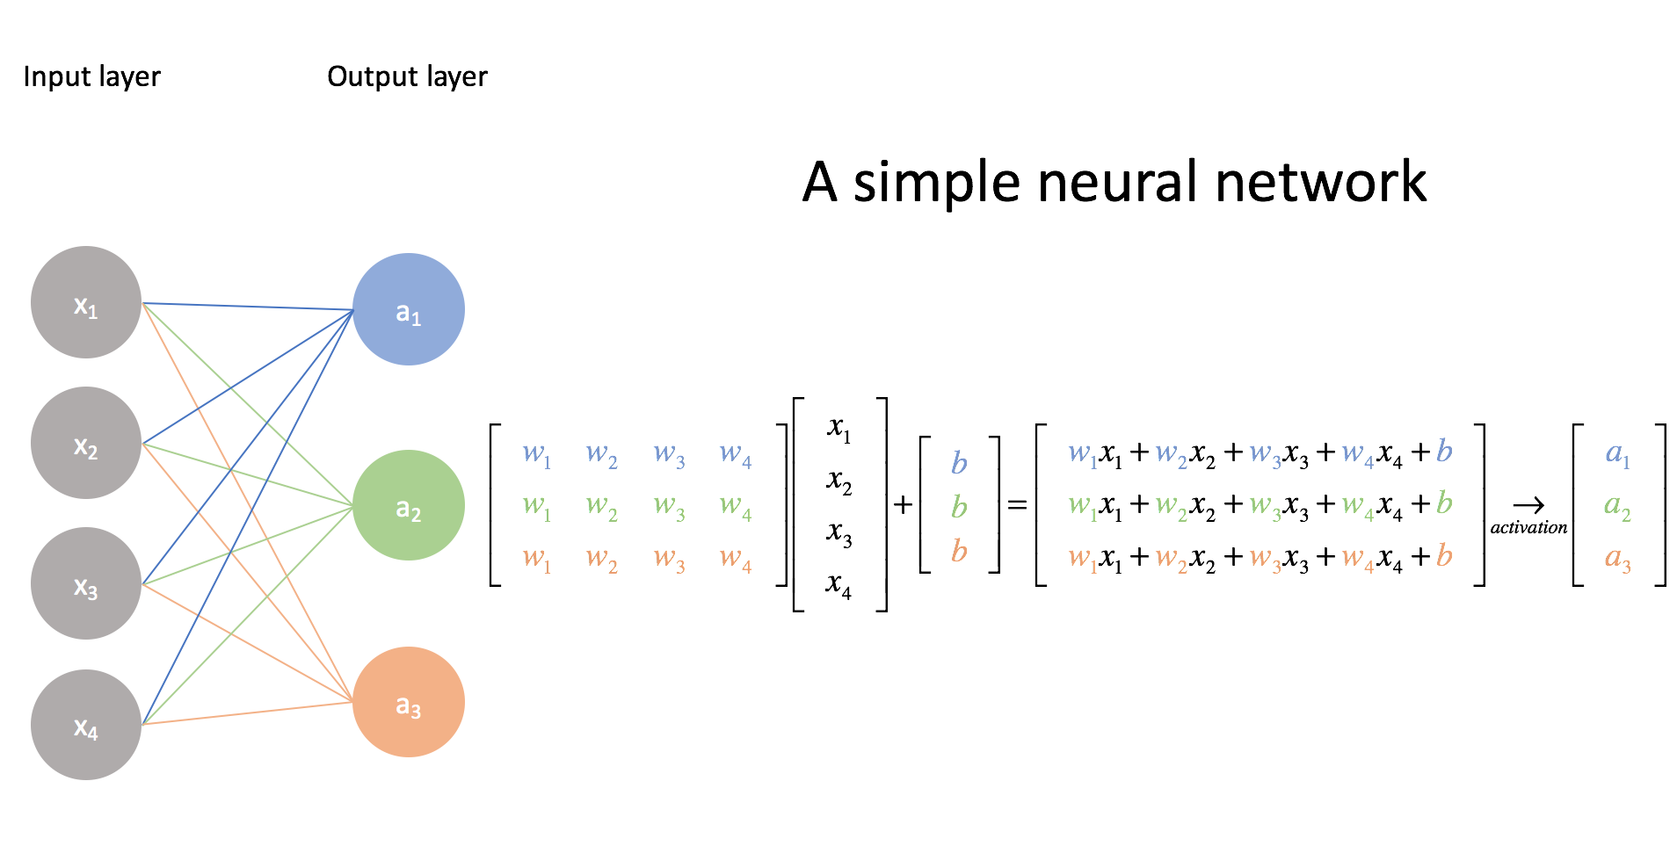
https://www.jeremyjordan.me/intro-to-neural-networks/

Slide 10
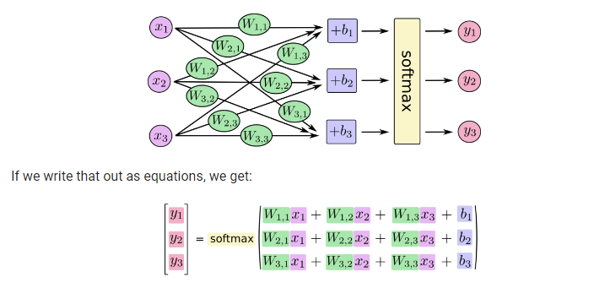
https://www.tensorflow.org/get_started/mnist/beginners

Slide 11
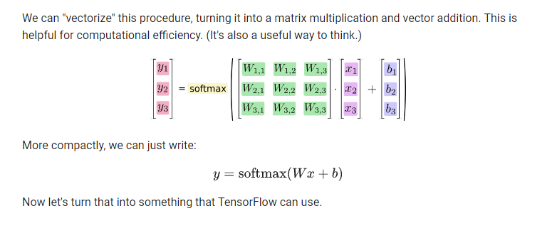
https://www.tensorflow.org/get_started/mnist/beginners

Slide 12
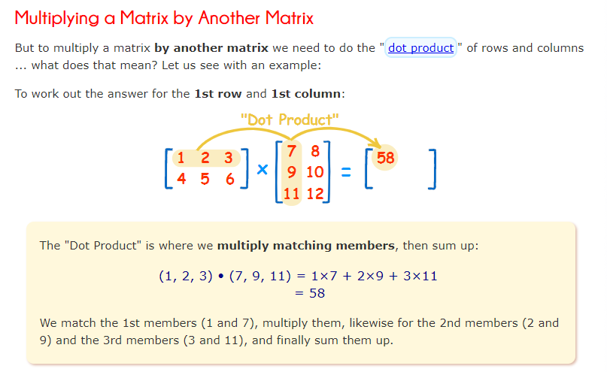
https://www.mathsisfun.com/algebra/matrix-multiplying.html

Slide 13
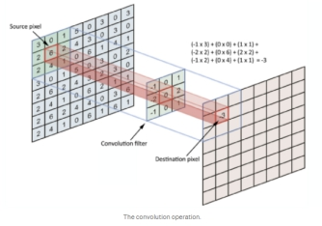

Slide 14
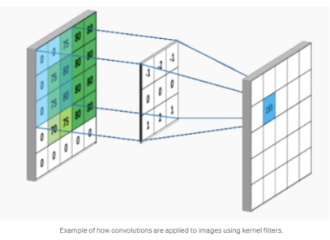

Slide 15
From a mathematical perspective, “Convolutional networks are simply neural networks that use convolution in place of general matrix multiplication in at least one of their layers." (reference Bengio – Goodfellow) i.e. instead of doing matrix-matrix multiplication between two layers, the convolution operation can be understood as a "kernel" or "filter" (a small matrix, e.g., 3x3) that slides over an input feature space (e.g., image, or the hidden layer units). Here, one sliding step does an element-wise multiplication between the "kernel" (e.g., 3x3) and an, e.g. 3x3 image patch resulting in an 3x3 output, which is summed up to a single number. This is repeated by sliding over the image then to obtain an output "image".

Slide 16
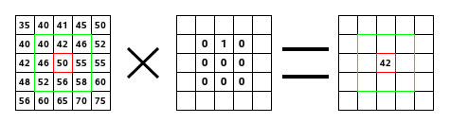
(40*0)+(42*1)+(46*0) + (46*0)+(50*0)+(55*0) + (52*0)+(56*0)+(58*0) = 42
https://docs.gimp.org/2.8/en/plug-in-convmatrix.html

Slide 17
Defining a simple neural net in Keras
We start with a very simple neural network and then progressively improve it.
Keras provides suitable libraries to load the dataset and split it into training sets X_train, used for fine-tuning our net, and tests set X_test, used for assessing the performance.
Data is converted into float32 for supporting GPU computation and normalized to [0, 1].
In the simplest cases, normalization of ratings means adjusting values measured on different scales to a notionally common scale, often prior to averaging

Slide 18
The input layer has a neuron associated with each pixel in the image for a total of 28 x 28 = 784 neurons, one for each pixel in the MNIST images.
Typically, the values associated with each pixel are normalized in the range [0, 1] (which means that the intensity of each pixel is divided by 255, the maximum intensity value). The output is 10 classes, one for each digit
The final layer is a single neuron with activation function softmax, which is a generalization of the sigmoid function. Softmax aggregates 10 answers provided by the previous layer with 10 neurons as a probability

Slide 19
Once we define the model, we have to compile the model so that it can be executed by the Keras backend (either Theano or TensorFlow).
Here we need to
1) select the objective function (what to minimize) that is used by the optimizer to navigate the space of weights (also called loss function/loss minimization)
2) select the optimizer that is the specific algorithm(how
to minimize the weights) used to update weights while we
train our model
3) We need to evaluate the trained model

Slide 20
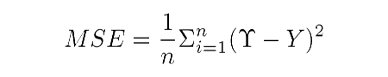
Some common choices for the objective function (a complete list of Keras objective functions is at https://keras.io/objectives/) are as follows:
MSE: This is the mean squared error between the predictions and the true values. Mathematically, if is a vector of n predictions, and Y is the vector of n observed values, then they satisfy the following equation:

Slide 21
These objective functions average all the mistakes made for each prediction, and if the prediction is far from the true value, then this distance is made more evident by the squaring operation.
Binary cross-entropy: This is the binary logarithmic loss. This objective function is suitable for binary labels prediction.
Categorical cross-entropy: This is the multiclass logarithmic loss. This objective function is suitable for multiclass labels predictions. It is also the default choice in association with softmax activation.

Slide 22
Some common choices for metrics (a complete list of Keras metrics is at https://keras.io/metrics/) are as follows:
Accuracy: This is the proportion of correct predictions with respect to the targets
Precision: This denotes how many selected items are relevant for a multilabel classification
Recall: This denotes how many selected items are relevant for a multilabel classification

Slide 23
Improving a baseline

Slide 24
MLP Code and exercise
improving the baseline

Slide 25
mnist_V1.ipynb --> the basic model (One hidden layer) - takes through the concept of model building, data loading, evaluating and prediction.
mnist_V2.ipynb --> just adds an additional hidden layer-- the concept of making model—deeper
mnist_V3.ipynb --> In the model adds a dropout layer to explain the concept of dropout and how it helps overcome overfitting.
mnist_V4.ipynb , mnist_V5.ipynb--> Now we start to experiment with optimizers (RMSProp, Adam).
mnist_V6.ipynb --> Change epochs (from 50 to 20)

Slide 26
mnist_V7.ipynb , mnist_V10.ipynb--> Change batch_size (256, 512)
mnist_V8.ipynb --> Uses SGD with specific learning rate-- so that effect of learning rate can be observed (Learning rate here remains constant throughout training)
mnist_V9.ipynb --> Here the change is in the number of hidden units (N-HIdden)

Slide 27
Spatial considerations
Convolutional Neural Networks

Slide 28
MLP makes no consideration for spatial features
In images, spatial (proximity) matters
Convolutional neural networks are characterised by locally connected shared weight layers.
Three types of layers: convolutional layer, pooling layer, fully connected layer

Slide 29
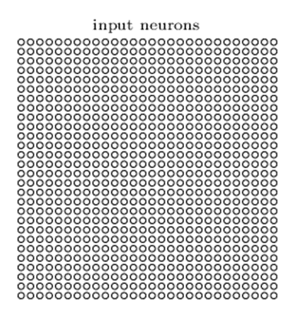
Image source http://neuralnetworksanddeeplearning.com/chap6.html

Slide 30
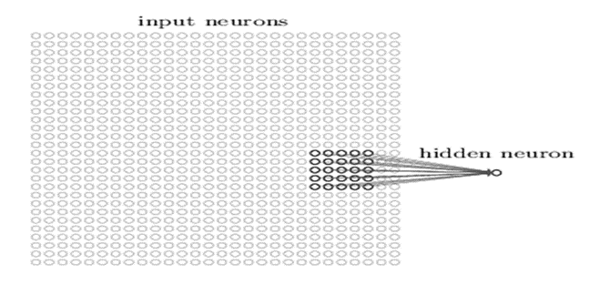
Instead of connecting every input pixel to every hidden neuron (like the MLP), we connect neurons only from a small localised region of the input image. Hence, each neuron in the first hidden layer will be connected to a small region of the input neurons, say, for example, a 5×5 region, corresponding to 25 input pixels.
Image source http://neuralnetworksanddeeplearning.com/chap6.html

Slide 31
That region in the input image is called the local receptive field for the hidden neuron. It's a little window on the input pixels. The hidden neuron learns to analyse its local receptive field.
We then slide the local receptive field across the entire input image. For each local receptive field, there is a different hidden neuron in the first hidden layer. To illustrate this concretely, let's start with a local receptive field in the top-left corner:

Slide 32
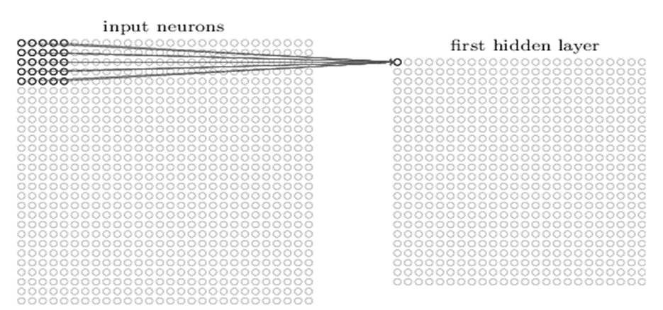
Image source http://neuralnetworksanddeeplearning.com/chap6.html

Slide 33
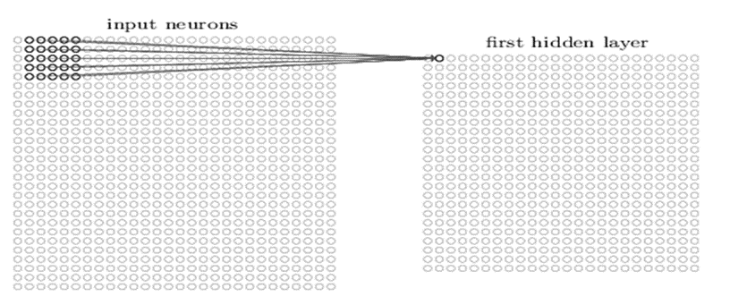
Then we slide the local receptive field over by one pixel to the right (i.e., by one neuron), to connect to a second hidden neuron:
Image source http://neuralnetworksanddeeplearning.com/chap6.html

Slide 34
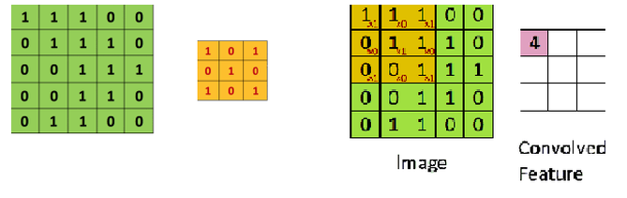
CONVOLUTIONAL LAYER- This layer will compute the output of neurons that are connected to local regions in the input, each computing a dot product between their weights and a small region they are connected to in the input volume.
34
Notes:
34

Slide 35
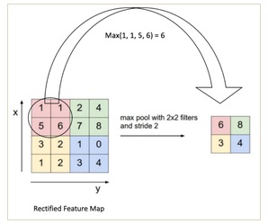
POOLING LAYER- Spatial Pooling also called sub-sampling or down-sampling, reduces the dimensionality of each feature map but retains the most important information.
Figure: Max pooling operation
35
Notes:
35

Slide 36
FULLY CONNECTED LAYER- The Fully Connected layer is a traditional Multi Layer Perceptron that uses a softmax activation function in the output layer (or sometimes other classifiers like SVM).
Now that we can detect these high-level features, the next stage is attaching a fully connected layer to the end of the network. This layer takes the output is of the layers preceding it and outputs an N dimensional vector where N is the number of classes that the program has to choose from. For example, if you wanted a digit classification program, N would be 10 since there are 10 digits.
36
Notes:
36

Slide 37
The network begins with 28×28 input neurons, which are used to encode the pixel intensities for the MNIST image.
This is then followed by a convolutional layer using a 5×5 local receptive field and 3 feature maps. The result is a layer of 3×24×24 hidden feature neurons.
The next step is a max-pooling layer, applied to 2×2 regions, across each of the 3 feature maps.
The result is a layer of 3×12×12 hidden feature neurons.
The final layer of connections in the network is a fully-connected layer. That is, this layer connects every neuron from the max-pooled layer to every one of the 10 output neurons.

Slide 38
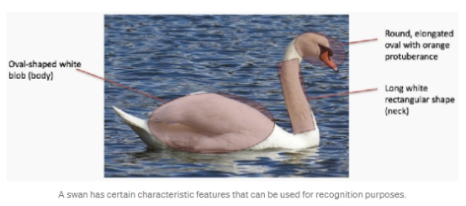
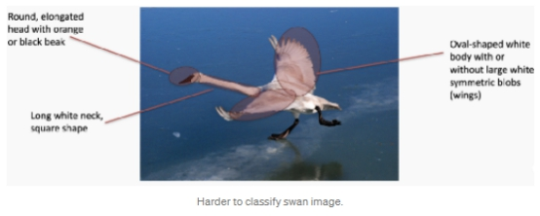
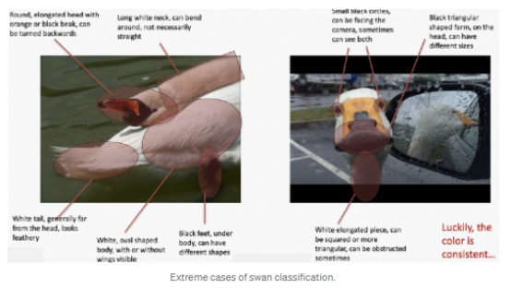
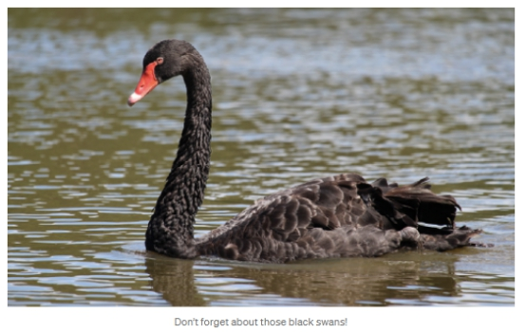

Slide 39
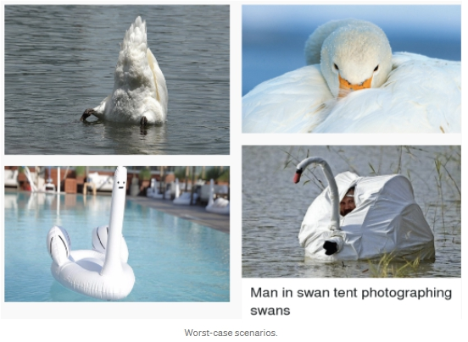

Slide 40
MLP drawbacks for image processing : One perceptron per input (hence the need to flatten the image as we saw in mnist). The amount of weights rapidly becomes unmanageable for large images.
Spatial information is lost when the image is flattened into an MLP.
Nodes that are close together are important because they help to define the features of an image.
Filters analyze the impact of nearby pixels
The max pooling step down samples the convolvoled features to save processing time
The fully connected layer acts as a classifier

Slide 41
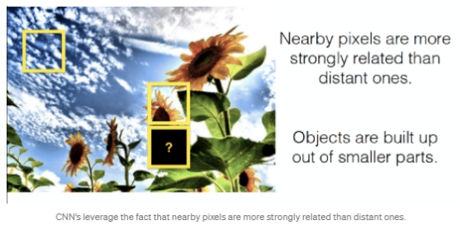

Slide 42
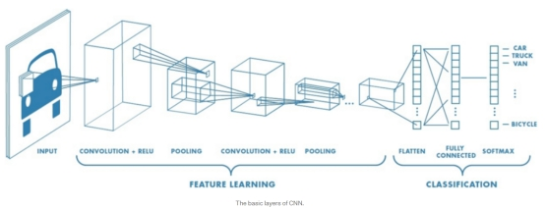
https://towardsdatascience.com/basics-of-the-classic-cnn-a3dce1225add

Slide 43
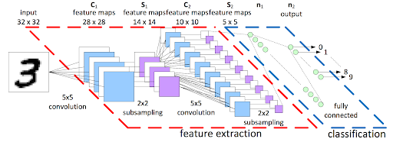
https://www.kaggle.com/cdeotte/how-to-choose-cnn-architecture-mnist

Slide 44
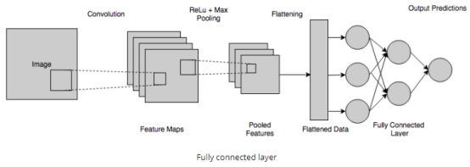
Introduction to convolutional neural networks - Nagesh Singh Chauhan

Slide 45
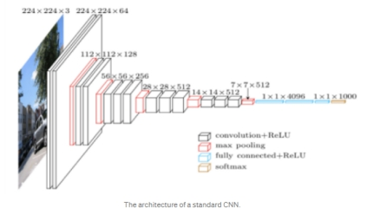
https://www.jeremyjordan.me/convnet-architectures/

Slide 46
How filters work …

Slide 47
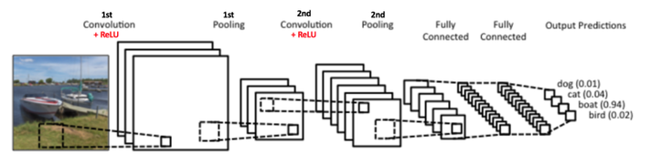
The neurons in a layer will only be connected to a small region of the layer before it, instead of all of the neurons in a fully-connected manner.
47
Notes:
47

Slide 48
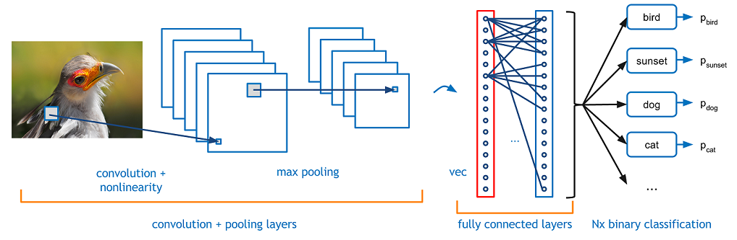
48
Notes:
48

Slide 49
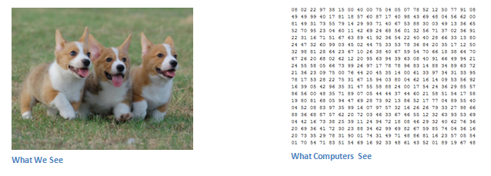
49
Notes:
49

Slide 50
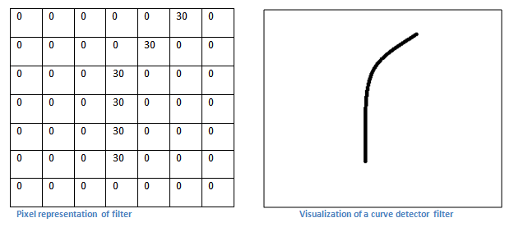
50
Notes:
50

Slide 51
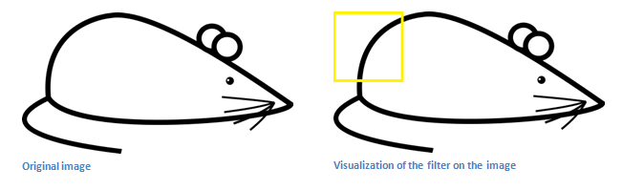
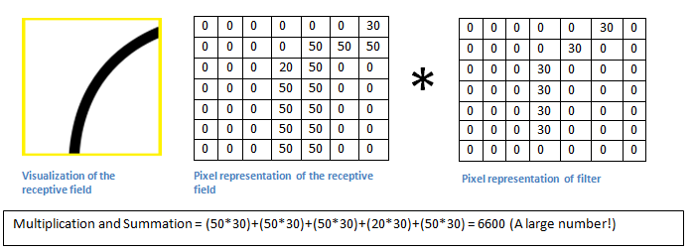
Remember, what we have to do is multiply the values in the filter with the original pixel values of the image.
51
Notes:
51

Slide 52
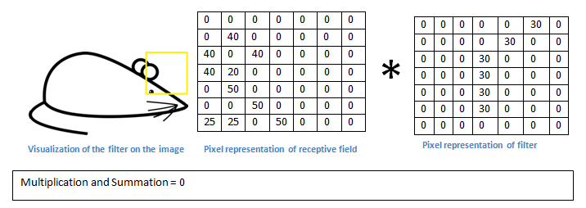
Basically, in the input image, if there is a shape that generally resembles the curve that this filter is representing, then all of the multiplications summed together will result in a large value! Now let’s see what happens when we move our filter.
52
Notes:
52

Slide 53
The value is much lower! This is because there wasn’t anything in the image section that responded to the curve detector filter. Remember, the output of this conv layer is an activation map. So, in the simple case of a one filter convolution (and if that filter is a curve detector), the activation map will show the areas in which there at mostly likely to be curves in the picture.
53
Notes:
53

Slide 54
References
https://www.kdnuggets.com/2019/12/enabling-deep-learning-revolution.html
https://adeshpande3.github.io/adeshpande3.github.io/A-Beginner's-Guide-To-Understanding-Convolutional-Neural-Networks/
https://pydeeplearning.weebly.com/blog/basics-of-convolutional-neural-networks

Slide 55
CNN layers – more detail

Slide 56
Comparison of Different Layers
There are three types of layers in a convolutional neural network:
convolutional layer
pooling layer, and
fully connected layer.
Each of these layers has different parameters that can be optimized and performs a different task on the input data.

Slide 57
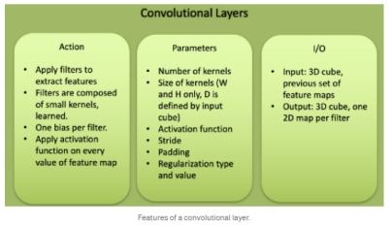
https://towardsdatascience.com/simple-introduction-to-convolutional-neural-networks-cdf8d3077bac

Slide 58
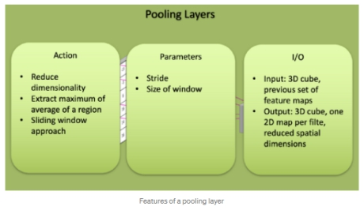
https://towardsdatascience.com/simple-introduction-to-convolutional-neural-networks-cdf8d3077bac

Slide 59
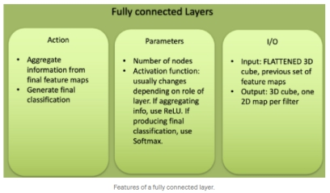
https://towardsdatascience.com/simple-introduction-to-convolutional-neural-networks-cdf8d3077bac

Slide 60
The CNN is a combination of two basic building blocks:
1.The Convolution Block — Consists of the Convolution Layer and the Pooling Layer. This layer forms the essential component of Feature-Extraction
2.The Fully Connected Block — Consists of a fully connected simple neural network architecture. This layer performs the task of Classification based on the input from the convolutional block.

Slide 61
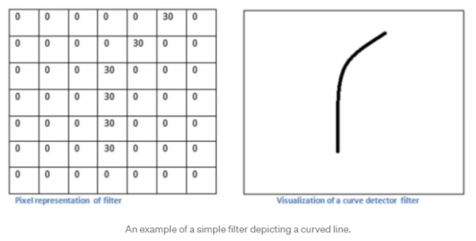
For example, let us take the picture of this curve. We take this as a sample feature that we will try to recognize, i.e., determine whether it is present in an image.

Slide 62
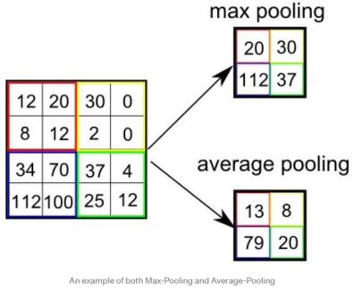
POOLING LAYER:
The Pooling layer consist of performing the process of extracting a particular value from a set of values, usually the max value or the average value of all the values. This reduces the size of the output matrix.

Slide 63
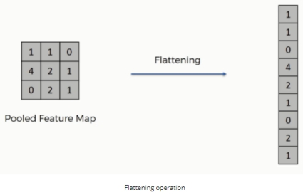
The rows are concatenated to form a long feature vector. If multiple input layers are present, its rows are also concatenated to form an even longer feature vector.

Slide 64
https://towardsdatascience.com/basics-of-the-classic-cnn-a3dce1225add

Slide 65
Simple Introduction to Convolutional Neural Networks - Matthew Stewart, PhD Researcher
An introduction to Convolutional Neural Networks - Christopher Thomas BSc Hons. MIAP
A Basic Introduction to Convolutional Neural Network - Himadri Sankar Chatterjee

Slide 66


Slide 67
A catch-up

Slide 68
A recap of Deep Learning and MLP

Slide 69
How to learn rules from Data?
The process of Machine Learning involves learning rules from Data.
Every machine learning algorithm has three components: representation, evaluation and optimisation. The process of representation involves setting up the data in such a way that it can be used by the system to build models. Once the system sees the data, the next step is the evaluation. In the evaluation stage, we use the data to learn the problem. Evaluation is followed by optimisation where we try to minimise or maximise the evaluation function (typically a loss function).

Slide 70
This strategy is called Representation learning, and it is one of the primary foundations of deep learning, i.e. the ability to detect features automatically from a dataset without human intervention. Representation learning gives deep learning (and AI) the power to be disruptive. Not only can we learn representations through deep learning, but we can also learn complex representations through a hierarchy of more straightforward representations. Representation learning is a compelling idea, and it underpins both deep learning and AI. The best-known examples of a deep learning network is the multi-layer perceptron(MLP)(explained in later sections). The MLP comprises of multiple layers of neurons that use a supervised algorithm called backpropagation for training.

Slide 71
We can think of MLP as a mathematical function mapping some set of inputs to some set of outputs. However, this single function can be seen as a hierarchy comprising of multiple sub-functions. Each layer can be seen as implementing a sub-function, and the subsequent layers build upon the outputs of the previous input. The technique is called deep learning because of the presence of multiple layers. We specify the inputs and the outputs, but the architectures of the interim layers are not defined. The machine learns the structure of the intermediate layers as part of the training process.

Slide 72
Hence, we can see deep learning as a specific kind of machine learning that achieves impressive results by learning the representation of concepts through a hierarchy of sub-concepts. In other words, the concept is supervised only at the higher level (ex: cat or dog), but the sub-concepts and their hierarchy are learned on their own. For example, a cat has whiskers, fur etc.

Slide 73
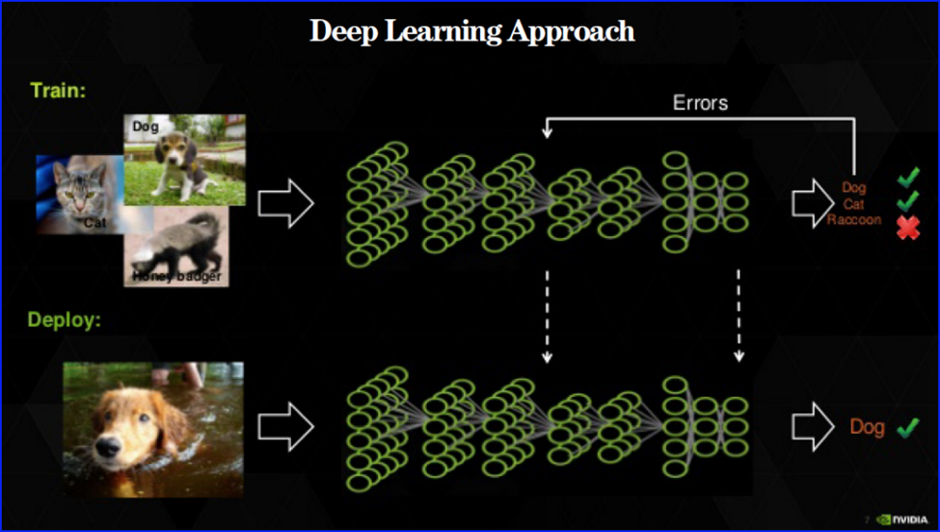
Image source: Nvidia

Slide 74
What problem does Deep Learning address?
Deep learning refers to artificial neural networks that are composed of many layers. The ‘Deep’ refers to multiple layers. In contrast, many other machine learning algorithms like SVM are shallow because they do not have a Deep architecture through multiple layers. The Deep architecture allows subsequent computations to build upon previous ones. We currently have deep learning networks with 10+ and even 100+ layers.
The presence of multiple layers allows the network to learn more abstract features. Thus, the higher layers of the network can learn more abstract features building on the inputs from the lower layers.

Slide 75
A Deep Learning network can be seen as a Feature extraction layer with a Classification layer on top. The power of deep learning is not in its classification skills, but instead in its feature extraction skills. Feature extraction is automatic (without human intervention) and multi-layered(hierarchal).
The network is trained by exposing it to a large number of labeled examples. Errors are detected and the weights of the connections between the neurons adjusted to improve results. The optimisation process is repeated to create a tuned network. Once deployed, unlabeled images can be assessed based on the tuned network.

Slide 76
Feature engineering involves finding connections between variables and packaging them into a new single variable is called a feature. Deep Learning performs automated feature engineering. Automated feature engineering is the defining characteristic of Deep Learning especially for unstructured data such as images(because unlike a housing dataset – you cannot identify a set of features for an image). This ability matters because the alternative is engineering features by hand. This is slow, cumbersome and depends on the domain knowledge of the people/person performing the Engineering. Deep Learning suits problems where the target function is complex and involve Hierarchy and Abstraction.

Slide 77
Abstraction is a conceptual process by which general rules and concepts are derived from the usage and classification of specific examples. We can think of an abstraction as the creation of a ‘super-category' which comprises of the common features that describe the examples for a specific purpose but ignores the ‘local changes' in each example. For example, the abstraction of a ‘Cat' would comprise fur, whiskers etc. For Deep Learning, each layer is involved with the detection of one characteristic, and subsequent layers build upon previous ones. Hence, Deep Learning is used in situations where the problem domain comprises abstract and hierarchical concepts. Image recognition falls in this category. In contrast, a Spam detection problem that can be modelled neatly as a spreadsheet probably is not a complex problem to warrant Deep Learning

Slide 78
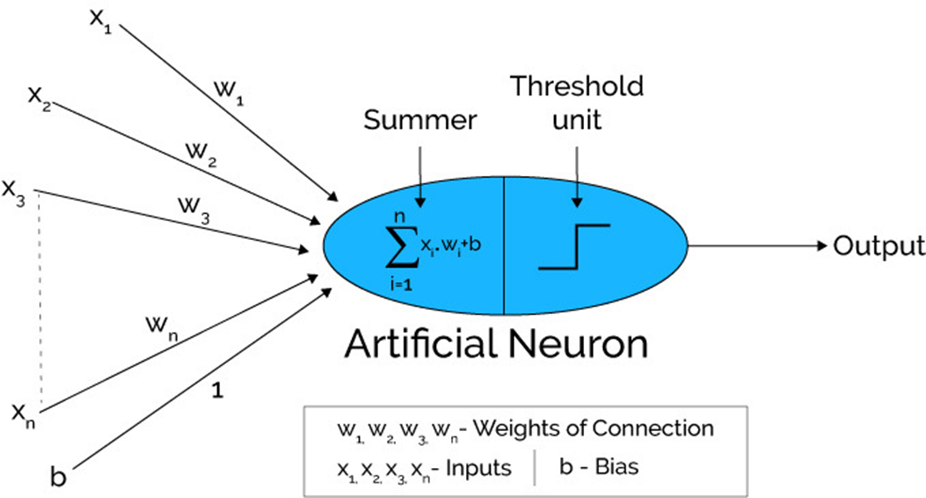
Image source: Xenon stack

Slide 79

A Neural Network contains a large number of artificial neurons called units arranged in a series of layers. In typical Artificial Neural Network, comprises different layers:

Slide 80
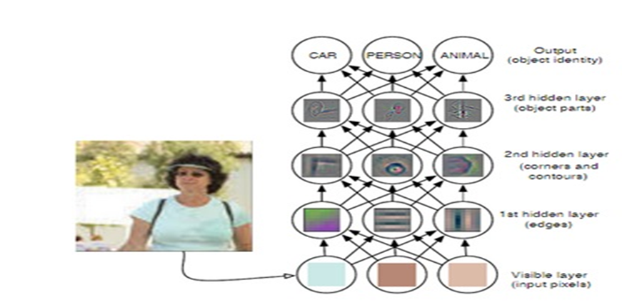
Image source

Slide 81
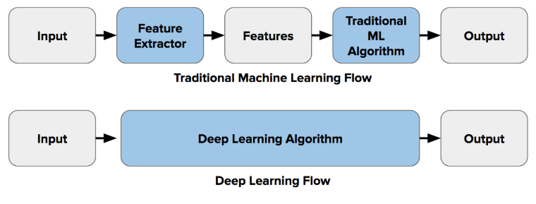
DL models use very large number of parameters and create complex and highly nonlinear representations.

Slide 82
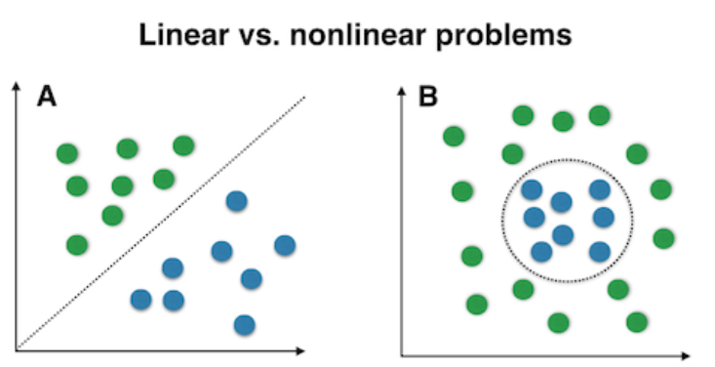
Deep learning models are inherently better to tackle such nonlinear classification tasks.

Slide 83
Temporal considerations - RNN/LSTM
In the previous section, we saw how CNNs manage spatial relationships. In this section, we will see how Recurrent Neural Networks (RNNs) work with temporal relationships in the data. In a traditional neural network model(MLP), we assume that all inputs (and outputs) are independent of each other. However, that is not true for some applications. For example, MLPs lose spatial information (which is catered to by CNNs). However, they also lose temporal information, i.e. sequence data. For example, in sequence prediction and language translation, the order of the words is important if you want to predict the next word.

Slide 84

To manage this, we need a type of neural network called Recurrent neural networks. In recurrent neural networks(RNN), the RNN performs the same task for every element of a sequence and the output at each element also depends on the previous computations. Because of this characteristic (the ability to use the outputs from previous calculations), RNN can be considered to have a “memory”.
Image source: Wikipedia

Slide 85
The most commonly used type of RNNs are LSTMs (Long Short-Term Memory), which are much better at capturing long-term dependencies in sequences. Training a RNN is similar to training a traditional Neural Network through backpropagation. However, RNNs share parameters across all time steps in the network. Hence, instead of using Backpropagation, we use a technique called Backpropagation through time.

Slide 86
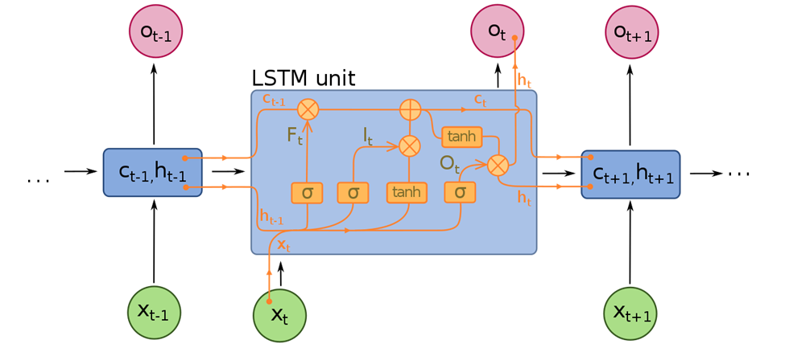
LSTM – image source Wikipedia

Slide 87
LSTM networks are a type of RNNs which use a different function to compute the hidden state. The memory in LSTMs are called cells which function as black boxes that take as input the previous state. LSTMs are designed to manage long sequences.

Slide 88


Slide 89
Videos

Slide 90
CNN - https://youtu.be/YRhxdVk_sIs
RNN - https://youtu.be/LHXXI4-IEns
LSTM- https://www.youtube.com/watch?v=8HyCNIVRbSU

